Slide 1
ONLINE CRIME REPORTING SYSTEM BY:- Tank Dipali (20SOECE13055). Rana Divya (20SOECE13048). Nanda Bansi (20SOECE13019).

Slide 2
CONTENT
Abstract
Introduction
Purpose
Requirement Gathering and Analysis
Methodology Used
Technology Used
System design
Limitation
Future Enhancement
Reference

Slide 3
ABSTRACT
We all know that nowadays crime rate is frequently increasing day by day in our society. From this we get an idea to develop the system.
Problem was that people got tired by going here and there for getting justice.
So our application is capable of registering FIR online , shows investigation update , deliver news about crime etc.
So it is an application which provide solution to the problems faced during taking action against crime.

Slide 4
INTRODUCTION
PURPOSE:-
To reduce the trouble of going to police station frequently.
To take a quick action against crime.
To get the information about the crime easily.
Reduces the man power.
Reduces the time.
Provides the current status of the crime rate.
To aware people about crime.

Slide 5
REQUIREMENT GATHERING AND ANALYSIS
EXISTING SYSTEM:-
All criminal records are stored in a file.
To add any new record , record file is used.
When other police station require any criminal information at that they need to call that police station.
There are many drawbacks like time consuming, require more man power.
Citizens can not get the information and the current status of the criminals of all cities.

Slide 6
PROPOSED SYSTEM
Citizens not need to go police station to see the criminals information.
They can directly see information on site.
Visitor can easily get the information about the crime.
Reduce the man power.
Reduce the time.
Member can view the current status of the crime investigation.

Slide 7
METHODOLOGY USED
SOFTWARE REQUIREMENT:-
Web server : Apache/ XAMPP
IDE : Sublime Text3
Database : MY SQL
Browser : Google Crome , Mozilla Firefox

Slide 8
HARDWARE REQUIREMENT
Processor : Intel Core i3-5005 2.0GHz
RAM : 4GB
Storage : 1GB
Display : For all devices

Slide 9
TECHNOLOGY USED
Front End :- HTML , CSS , Bootstrap , JavaScript , J Query , AJAX
Server Side :- PHP
Database :- My SQL

Slide 10
SYSTEM DESIGN
ER Diagram
Data Flow Diagram

Slide 11
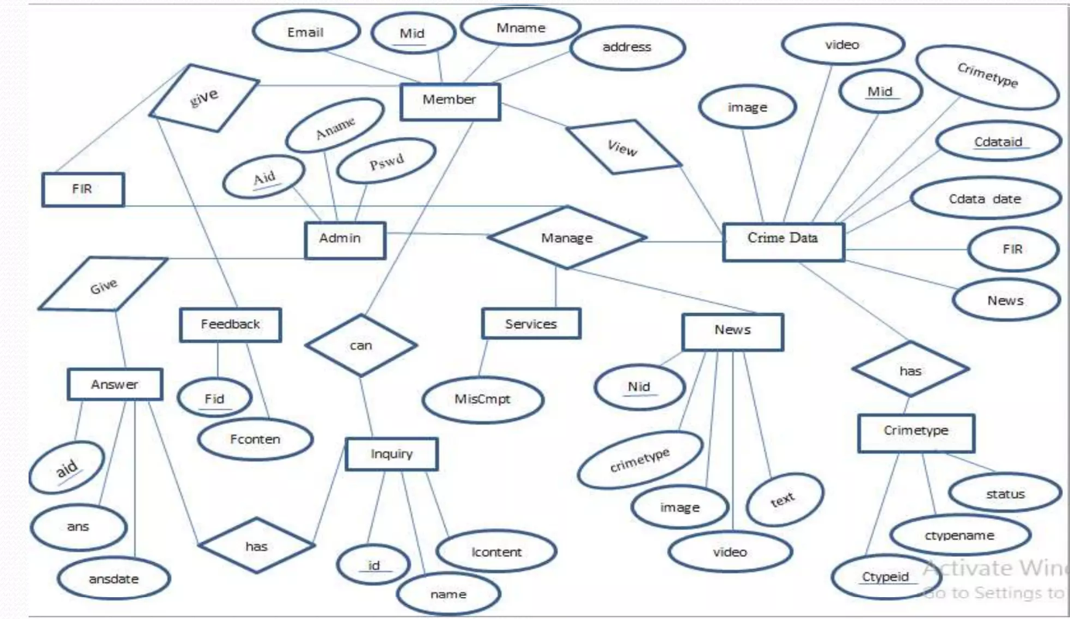
ER DIAGRAM

Slide 12
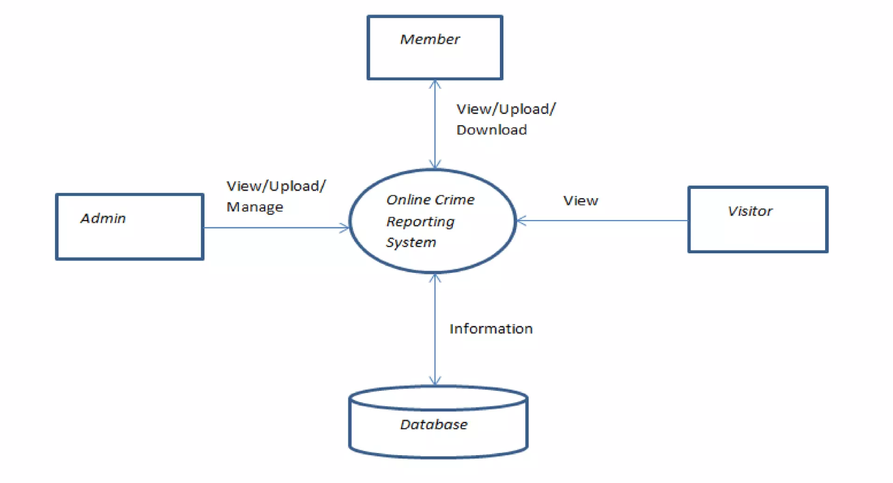
DATA FLOW DIAGRAM
LEVEL 0 DFD:-

Slide 13
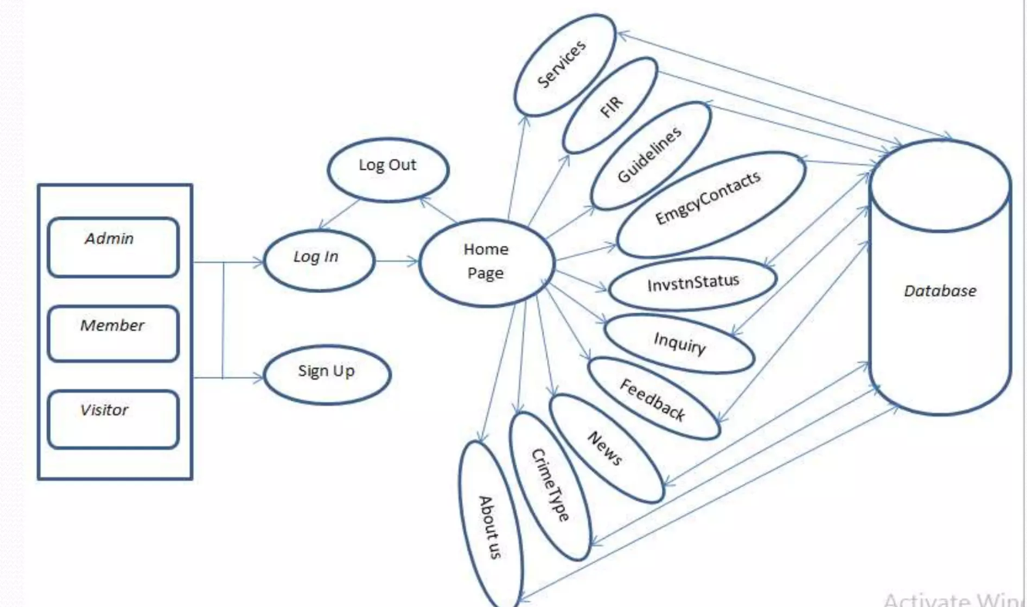
LEVEL- 1 DFD

Slide 14
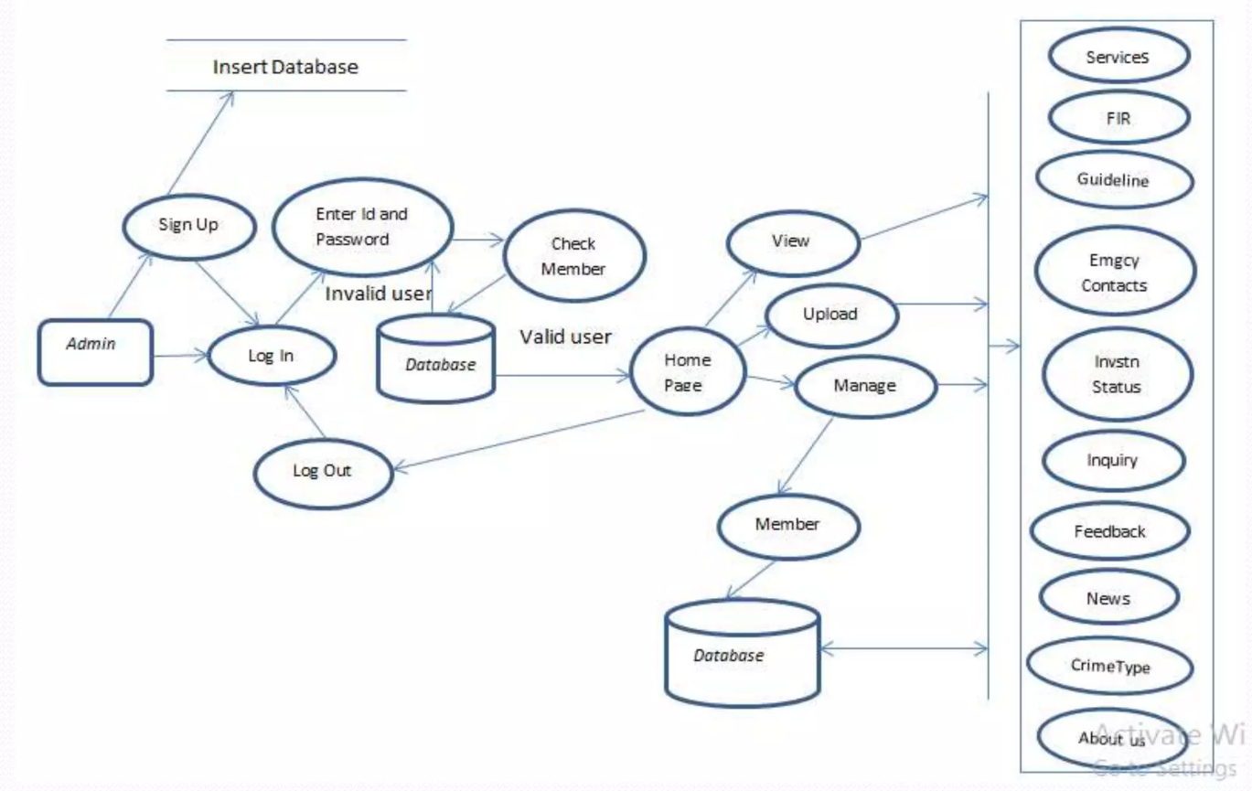
LEVEL-2 DFD ADMIN

Slide 15
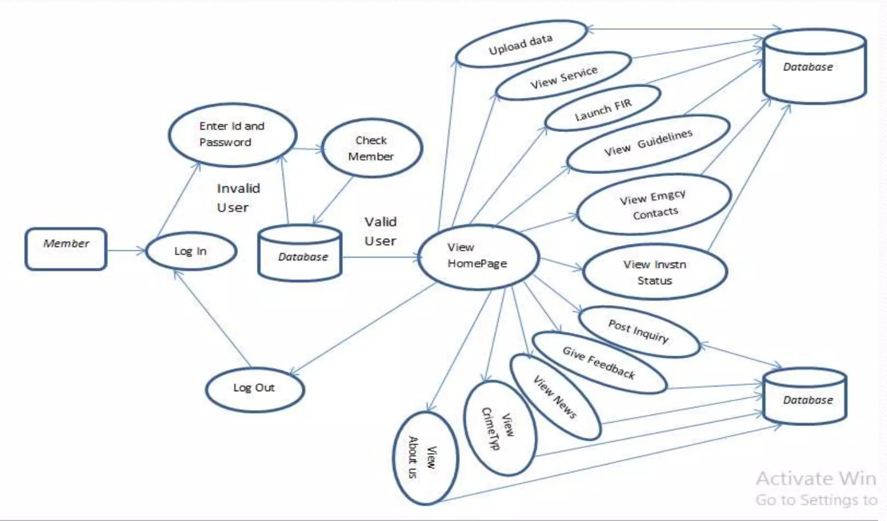
LEVEL - 2 DFD of Member :-

Slide 16
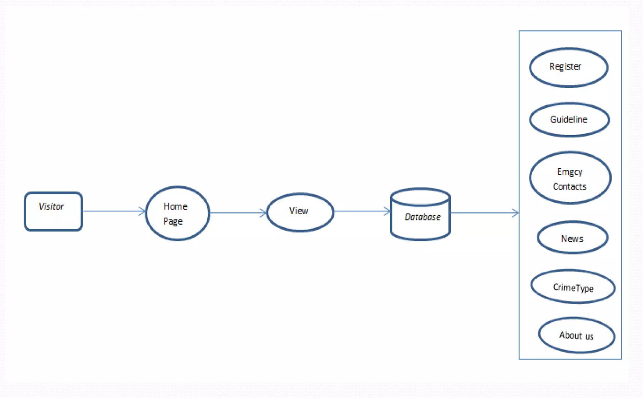
LEVEL 2 DFD of Visitor

Slide 17
LIMITATIONS
Only admin and member can login this portal.
In our application live chat app functionality is not available.
Visitors can only see information’s like news , guidelines , crime types , emergency contacts , about us etc.

Slide 18
FUTURE ENHANCEMENT
In future , system will provide mail facility to members. Members can send mail to other stations.
In future , system will provide online live chat application.
In future , system will provide facility to send message related to crime to the peoples.

Slide 19
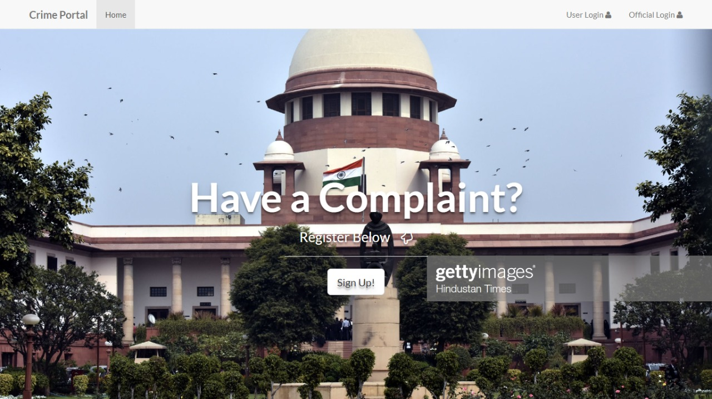
SCREEN SHORT

Slide 20
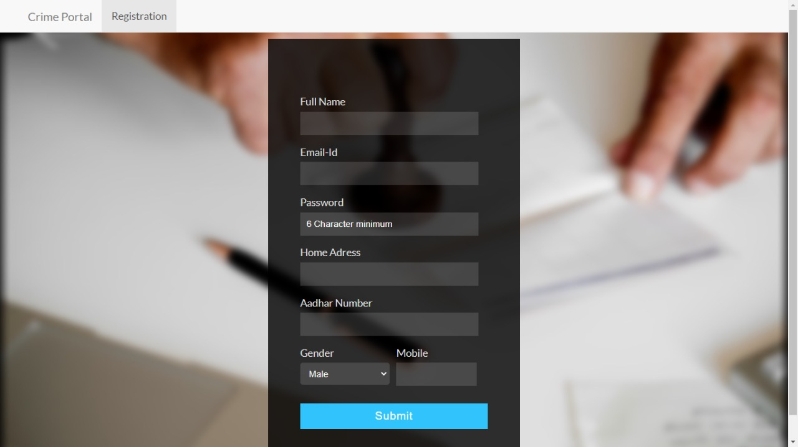
Registration

Slide 21
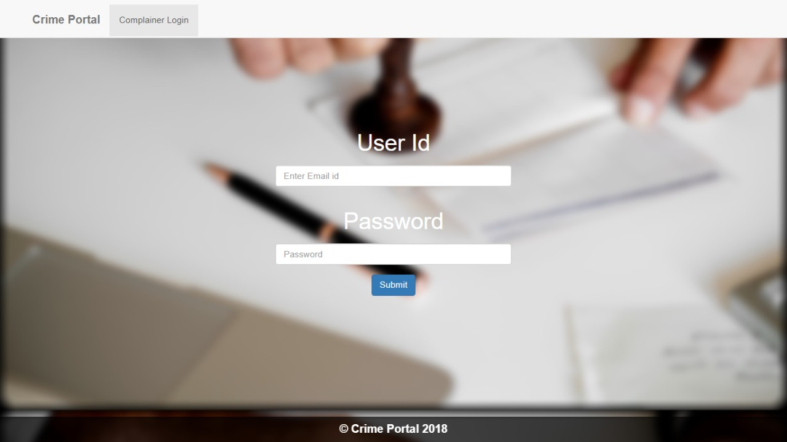
Login

Slide 22
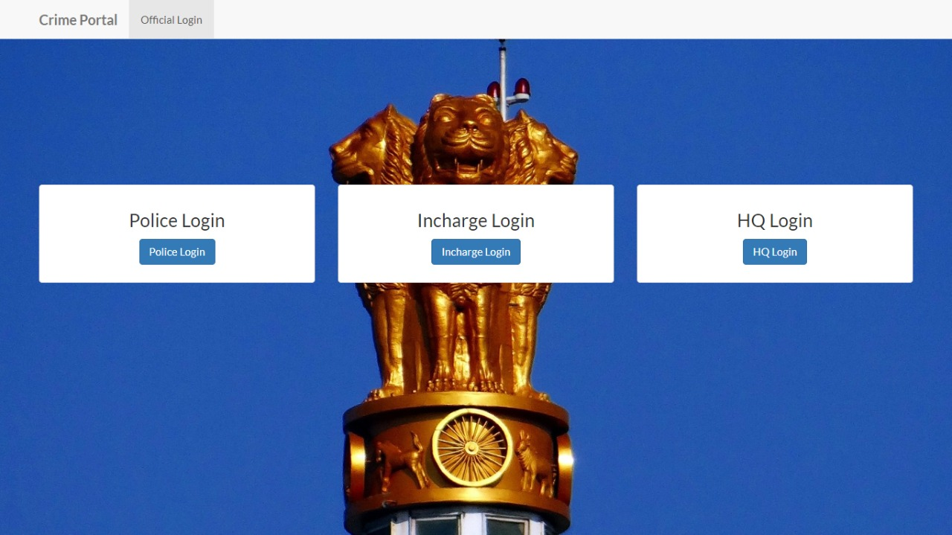
Office Login

Slide 23
REFERENCES
www.W3schools.com
www.crime.com
www.newsfast.tv
www.crime.info

Slide 24
THANK YOU

